Slide 1


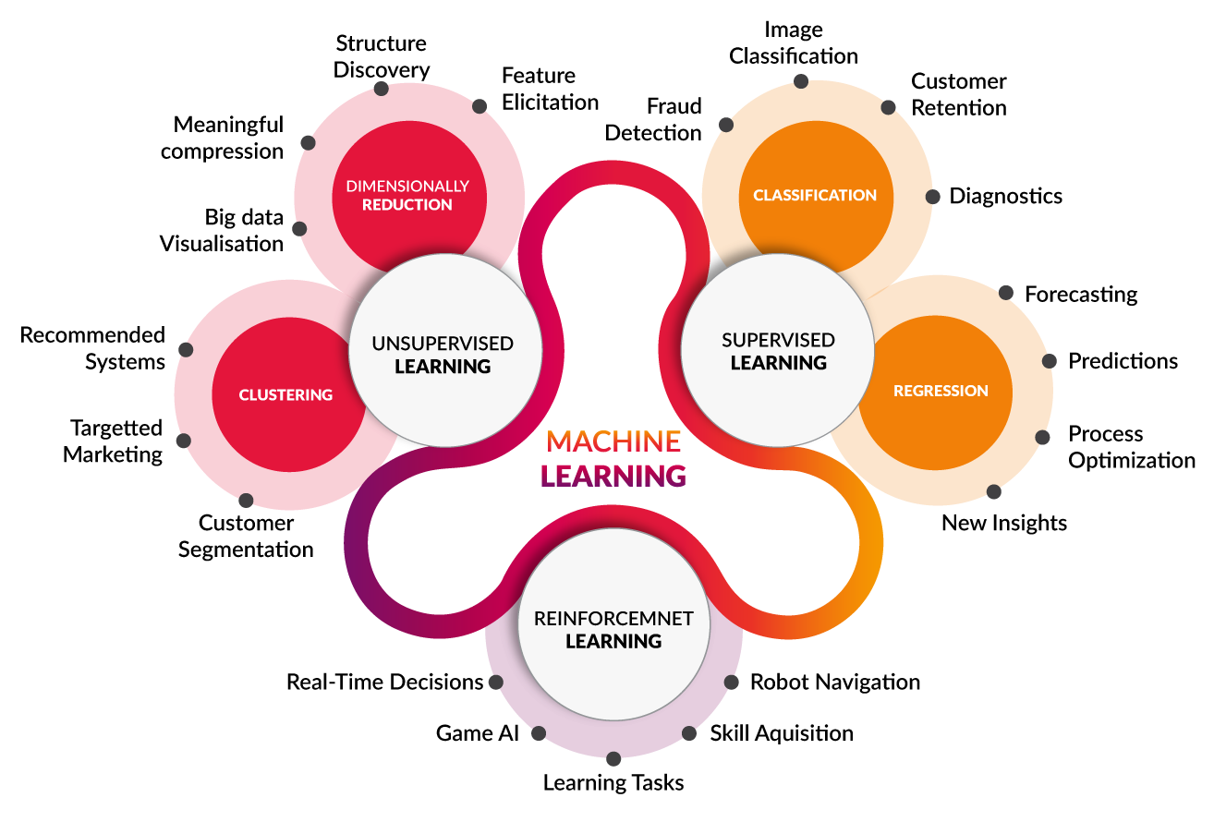
MACHINE
LEARNING

Slide 2


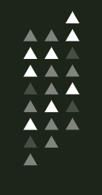

SETUP AND INSTALLATION

Slide 3


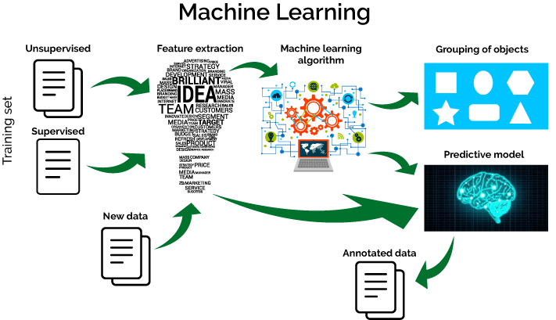
WHAT
IS ML?
WHY
ML??

Slide 4


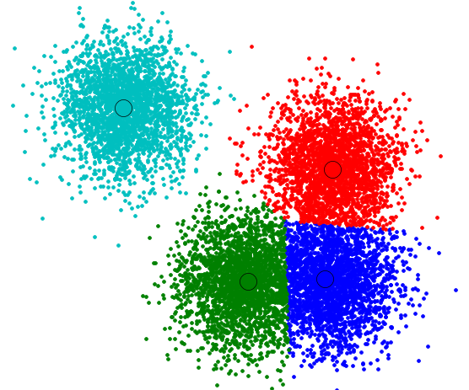

CLUSTERING

Slide 5



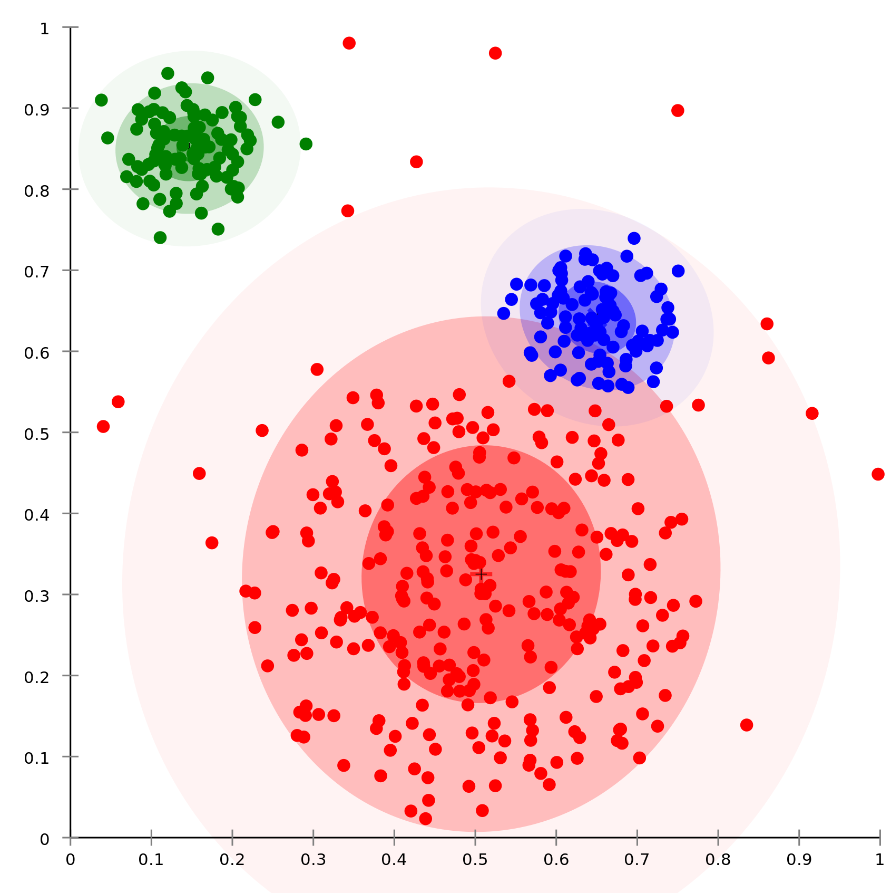

K-MEANS
K-MEDIAN
K-MEDIOD

Slide 6

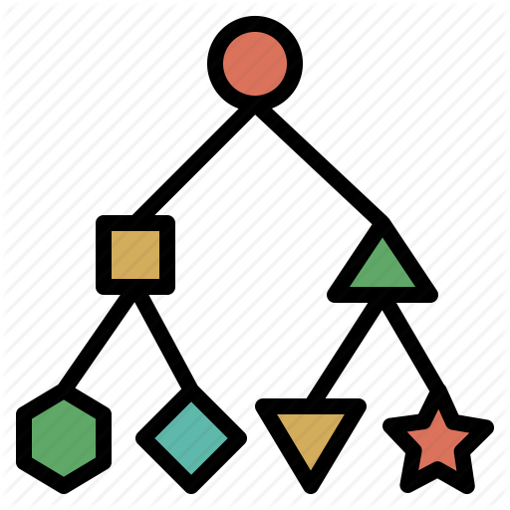

CLASSIFICATION

Slide 7



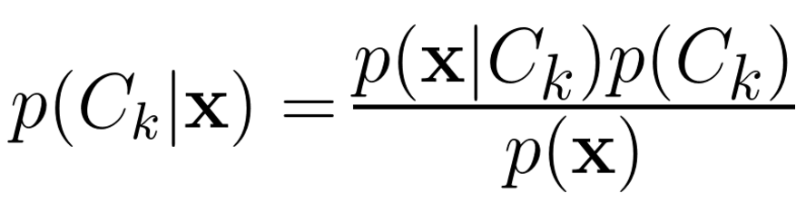
NAÏVE
BAYES

Slide 8

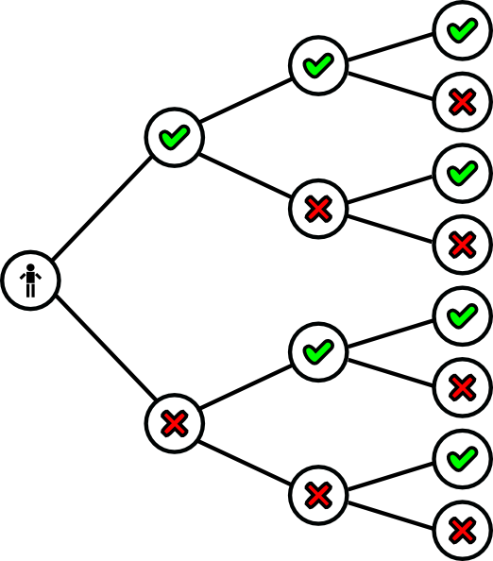


DECISION TREE

Slide 9

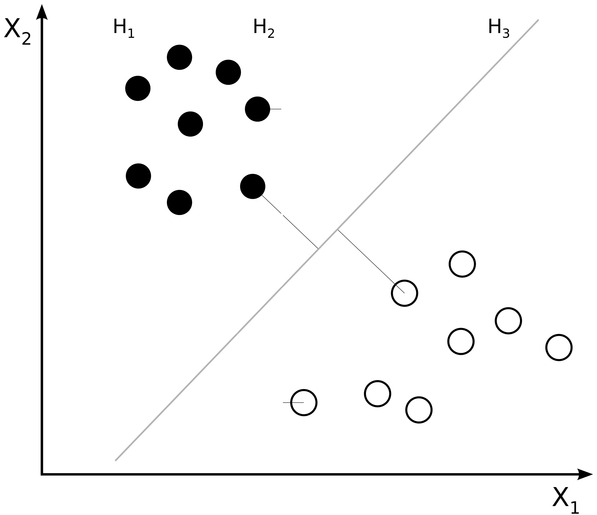

SUPPORT VECTOR MACHINE

Slide 10

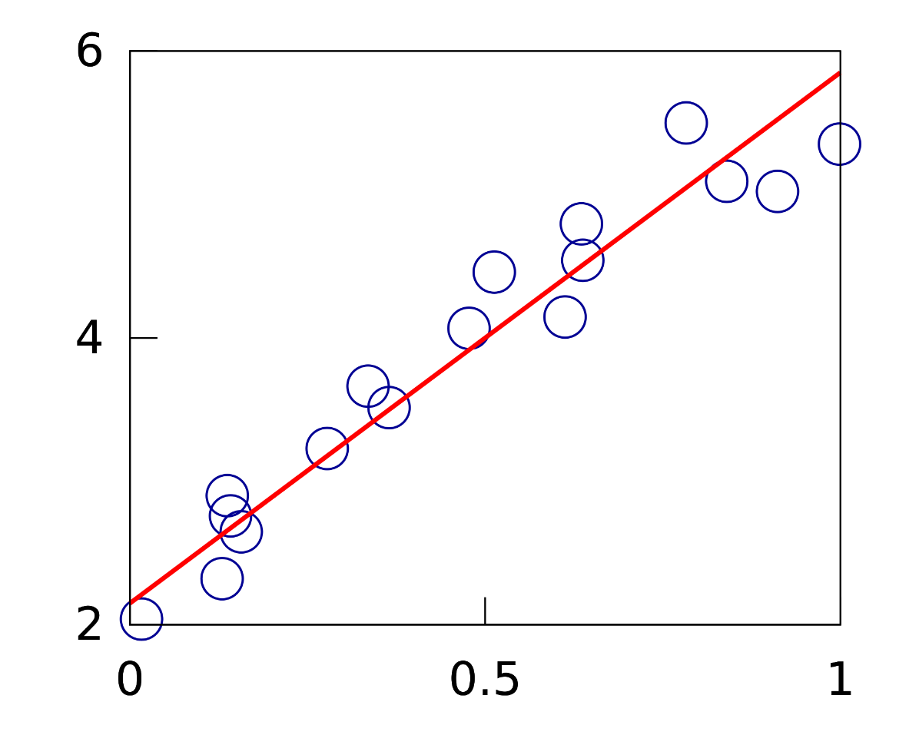


LINEAR REGRESSION

Slide 11


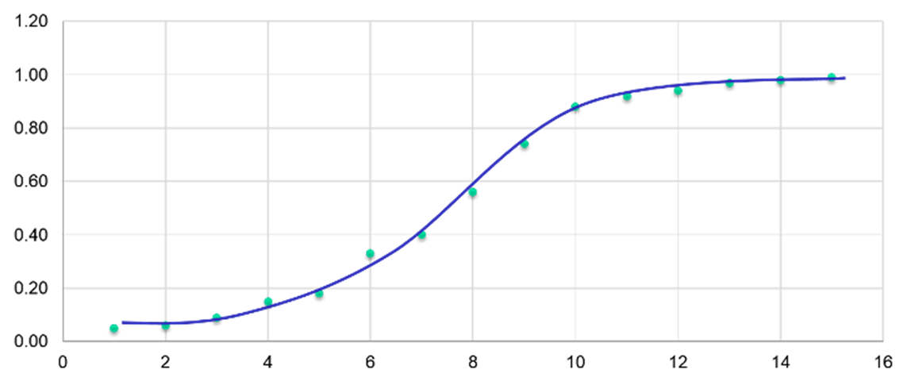

LOGISTIC REGRESSION

Slide 12


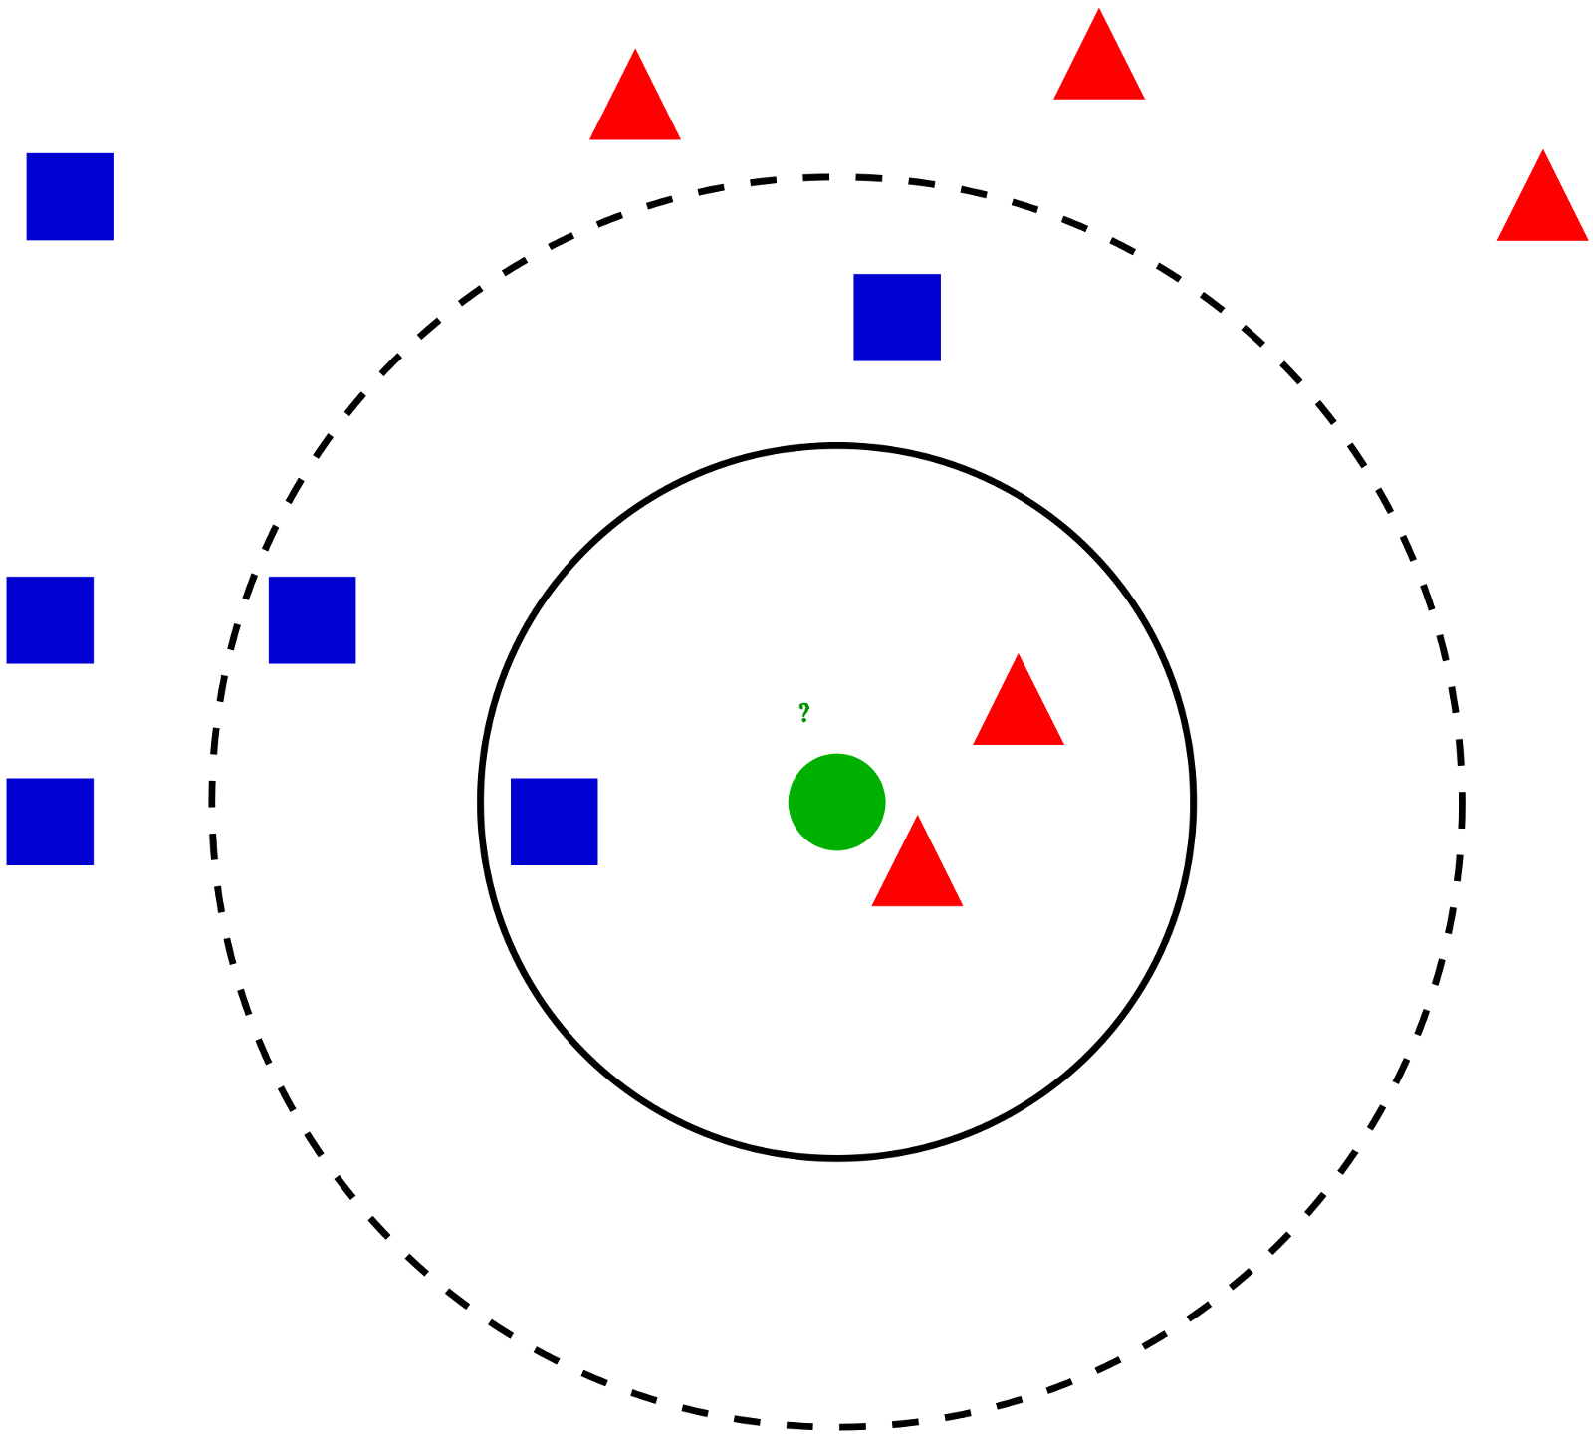

K- NEAREST NEIGHBOUR

Slide 13


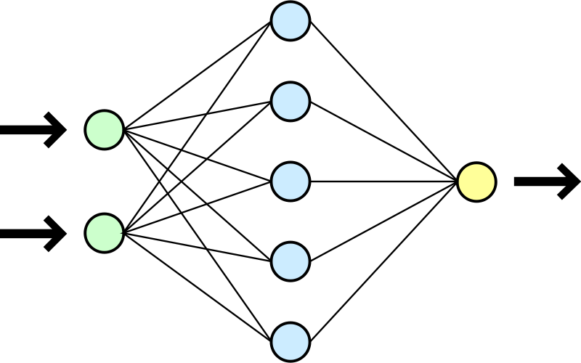

NEURAL NETWORKS

Slide 14



ANY QUESTIONS

